Slide 1
Beyond the Code: A Unique Journey of a Bioinformatics Student
Lab meeting
2024-03-20
@HighlanderLab

Slide 2
Elevator pitch
I'm currently pursuing a Master’s in Bioinformatics at the University of Edinburgh. My expertise spans Java, Python, and data analysis, so as I complete my Master's, I'm looking to bring my bioinformatics and software engineering knowledge to tackle new challenges.

Slide 3
Current project

Slide 4
Strategies to Improve Adaptation in Plant Breeding with Complex Genotype by Environment Interactions
Supervisors: Dr. Daniel Torhurst, Dr. Gregor Gorjanc
Presented by: Shuren Xie
Notes:
Hello everyone, my name is Shuren Xie, and here is my research title, Strategies to Improve Adaptation in Plant Breeding with Complex Genotype by Environment Interactions. And I am supervised by Dr. …

Slide 5
Outline of Presentation
Background/Introduction
Statement of problem
Research question and hypothesis
Methodology
Data & Processing
Data Visualization
Reference
Notes:
And here is the outline of this presentation.

Slide 6
Background /Introduction
In the next decades, the agricultural systems will deal with major challenges linked to the expected population growth, climate changes and necessity of sustainable use of resources able to preserve the environment. In this scenario, the development of stable varieties, adapted to various pedoclimatic conditions, marginal habitats and/or low-input farming systems is an imperative target for genetic improvement programs.
Animal and plant breeding is complicated by the fact that individuals respond differently to different environments, a phenomenon known as genotype by environment (G x E) interaction. The G x E analyses have been focused on identifying stable genotypes for crop production.
Notes:
Firstly is the introduction. In the face of population growth, climate change, and the need for sustainable resource use, developing stable crop varieties adaptable to diverse conditions and low-input farming is crucial. The challenge in breeding lies in the genotype by environment (G x E) interaction, which makes some individuals respond differently across environments. Our goal is to identify genotypes that consistently perform well, ensuring food security and environmental preservation.

Slide 7
Statement of problem
Statistically, G x E interactions are detected as a significantly different pattern of responses among the genotype across environments and biologically, this will occur when the contributions (or level of expression) of the genes regulating the trait differ among environments. Identification of stable genotypes which show the least G x E interaction is important consideration in sites where environmental fluctuations are noticeable.
Challenging: G x E and yield stability have been encounter to the breeders and biometricians for a long of time because it complicates the selection of superior genotypes by reducing the genetic progress.
Notes:
And G x E interactions present a unique problem: different genotypes react unpredictably across diverse environments. This complexity hinders the identification and selection of superior, stable genotypes, impeding genetic progress, especially where environmental variations are significant. Addressing this issue is vital for breeders and biometricians striving for yield stability.

Slide 8
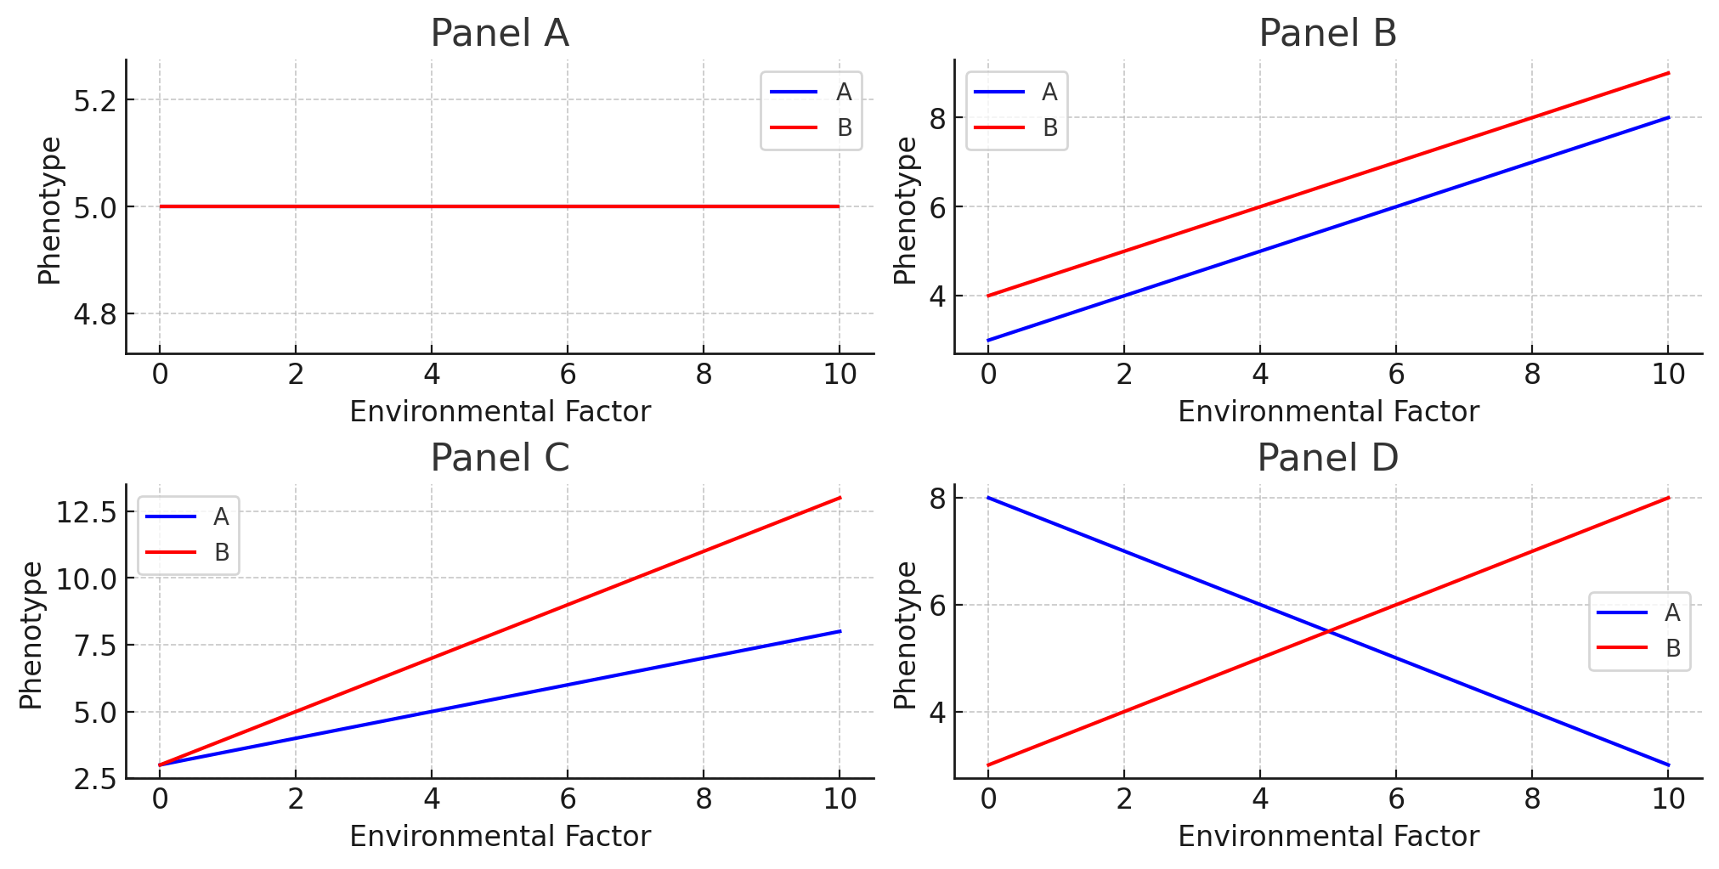
Notes:
generally, A conceptual GXE interaction is depicted as the slope of the line when genotype performance is plotted against an environmental gradient.
Here are some examples of different GxE interactions.
Panel (A) shows that the traits for A and B stay the same, no matter the environment.
Panel (B) has A and B changing the same way as the environment changes. So, no special interaction here.
Panel (C) shows A and B both change as the environment does, but A changes a lot more when things get tougher.
Panel (D) is where A and B switch places in how well they do when the environment changes.

Slide 9
Research question and hypothesis
The aim of this project is to explore different replication strategies that result in better adapted plant varieties for farmers.
Randomized Complete Block Design, RCBD
Split-Plot Design
Adaptive Design
Environmental Gradient Design
Multi-location Yearly Trials
Age-Series Designs
Notes:
And the aim is to explore different replication strategies that result in better adapted plant varieties. And here are some possible strategies.

Slide 10
Methodology
Randomized Complete Block Design (RCBD): RCBD involves replicating each variety within blocks across different environments to control for environmental variation within each block.
Split-Plot Design: In split-plot designs, main treatments (e.g., irrigation levels) are randomized over large plots, with sub-treatments (e.g., varieties) randomized within these plots.
Adaptive Designs: Adaptive designs use preliminary results to modify the ongoing experiment, focusing on the most promising varieties for further testing.
Environmental Gradient Design: This approach tests varieties across a range of sites with environmental gradients to assess genotype performance under varying conditions.
Multi-location Yearly Trials: Varieties are tested across multiple locations and years to evaluate performance stability and environmental adaptability.
Age-Series Designs: Age-series designs track the performance of varieties over different growth stages to assess traits that manifest over time.
Notes:
And here are the core ideas for each strategy.

Slide 11
Data & Processing
Data Collection
Gather data on phenotypic traits across multiple environments and replicates, including yield, disease resistance, growth rates, and environmental factors such as soil quality, temperature, and rainfall.
Data Simulation
Using R libraries such as AlphaSimR.
Data Analysis
Linear Mixed Models (LMM)
Use LMM to account for both fixed effects (e.g., genotype, treatments) and random effects (e.g., environmental variation, block effects), isolating the GxE interaction component for each variety.
Basic Machine Learning Models
Apply machine learning models like Random Forests or Support Vector Machines to capture complex, non-linear GxE interactions and predict optimal genotype-environment combinations, using cross-validation for model assessment.
Simulate breeding procedure
Notes:
Let’s talk about how we figure out the best plant varieties for different farms. First, we collect information on how plants grow in various places—how much they produce, how they handle disease, and what their growing conditions are like.
Or we could use generated fake data for model training.
Next, we analyse this with two methods.
One is fitting linear mixed models, which help us find the fixed effects of our plant varieties and treatments from the random noise of environmental variability. This way, we can pinpoint the GxE interactions for each variety with precision.
The other is machine learning, where we employ algorithms like Decision Trees. And these models performs well in discovering the complex, non-linear relationships in our data, allowing us to predict the most resilient genotype-environment combinations. And to ensure our models are robust, we validate them through cross-validation techniques.
And We could also simulate a population with AlphaSimR, incorporating known genetic effects and breeding strategies.
Together, these analytical tools guide us to identify the most adaptable plant varieties for diverse farming conditions.

Slide 12
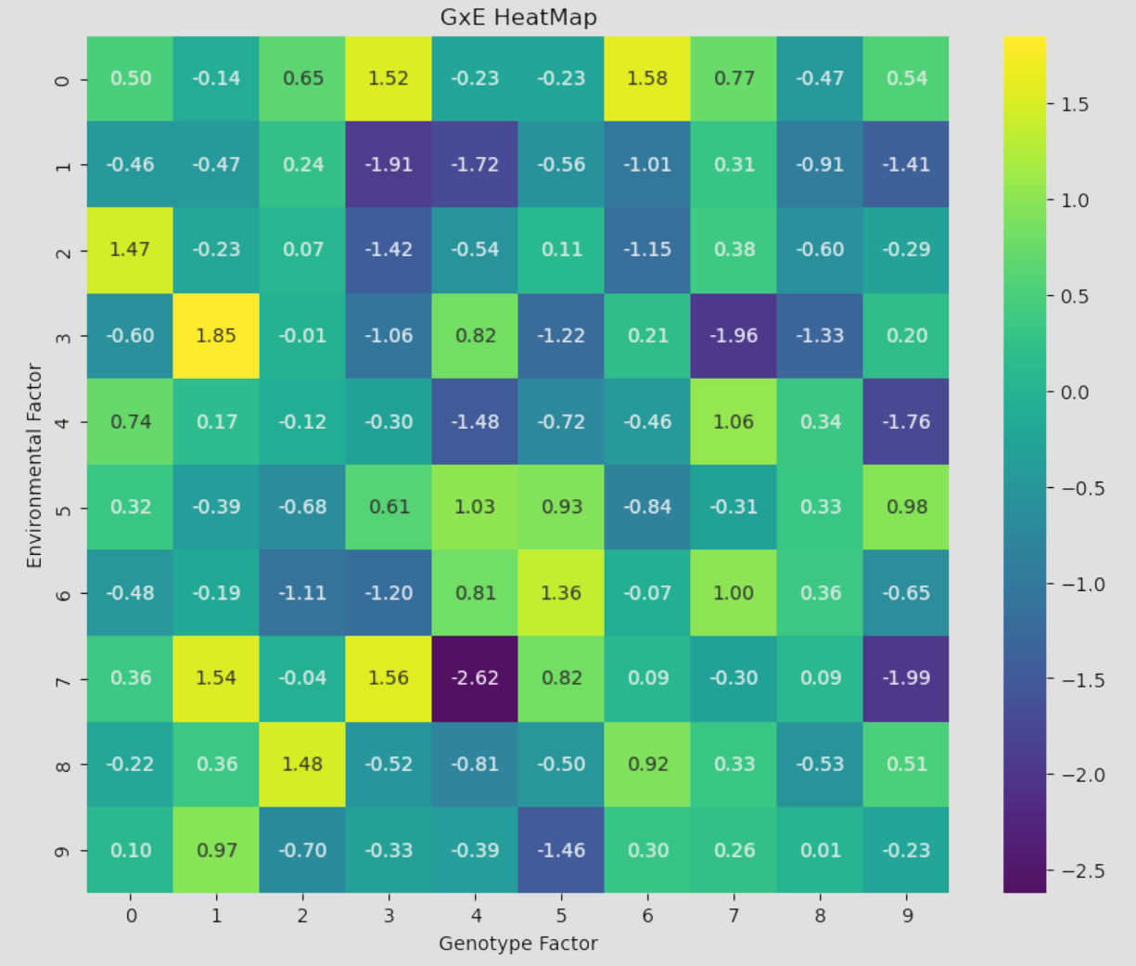
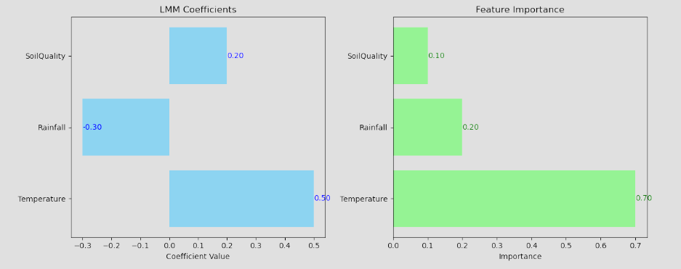
Data Visualization
Notes:
And here are some visualization examples to help us find the main effects or feature importance.

Slide 13
Reference
Cooper, Mark, and Carlos D. Messina. “Can We Harness ‘Enviromics’ to Accelerate Crop Improvement by Integrating Breeding and Agronomy?” Frontiers in plant science 12 (2021): 735143–735143.
Egea-Gilabert, Catalina, Mario A. Pagnotta, and Pasquale Tripodi. 2021. "Genotype × Environment Interactions in Crop Breeding" Agronomy 11, no. 8: 1644. https://doi.org/10.3390/agronomy11081644Methodology
Teressa, Temesgen & Semahegn, Zigale & Bejiga, Tamirat. (2021). Multi Environments and Genetic-Environmental Interaction (GxE) in Plant Breeding and its Challenges: A Review Article. International Journal of Research Studies in Agricultural Sciences. 7. 11-18. 10.20431/2454-6224.0704002.
Marvellous Zhou Marvellous.Zhou@sugar.org.za , Shailesh Vinay Joshi & Tracy Maritz (2012) Trends and Implications of Genotype by Environment Interaction in South African Sugarcane Breeding, Journal of Crop Improvement, 26:2, 163-176, DOI: 10.1080/15427528.2011.622429
van Eeuwijk, Fred A et al. “Modelling strategies for assessing and increasing the effectiveness of new phenotyping techniques in plant breeding.” Plant science : an international journal of experimental plant biology vol. 282 (2019): 23-39. DOI:10.1016/j.plantsci.2018.06.018
Ahmad, Muhammad et al. “Adaptation Strategies to Improve the Resistance of Oilseed Crops to Heat Stress Under a Changing Climate: An Overview.” Frontiers in plant science vol. 12 767150. 15 Dec. 2021, DOI:10.3389/fpls.2021.767150

Slide 14
Projects I have done
Notes:
An overview

Slide 15
A Chinese medicine database
Some bioinformatics pipelines
Some machine learning models
Shopping website and wechat mini program(Evolving from petri dishes to digital carts)
Notes:
An overview

Slide 16
Chinese medicine database
Collected and categorised information on specific Chinese medicines by the developed software.
Realised the automatic analysis function, enabling the experimenter to generate a research report promptly.
Notes:
Have some interfaces.
Led the development and maintenance of the system, implemented with Java and Python.

Slide 17

















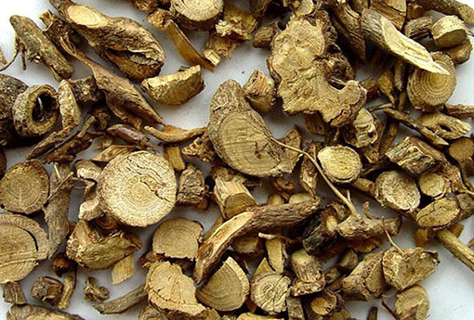
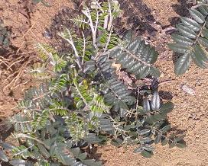


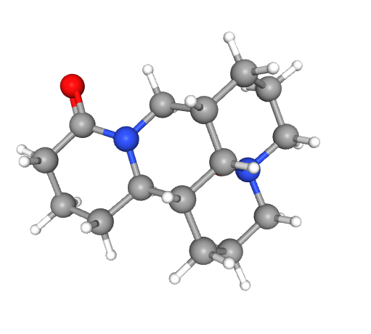


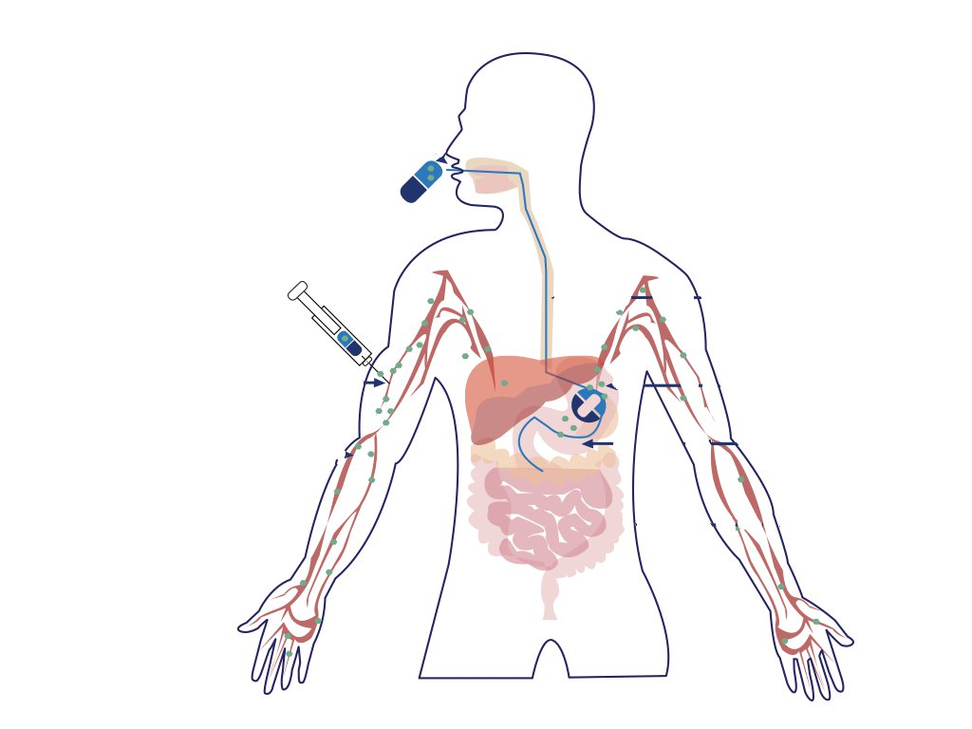



IVIVE System
.…
.…
文件 (F)
编辑 (E)
视图 (V)
工具 (T)
用户 (U)
同步 (S)
帮助 (H)
.…
.…
.…
.…
.…
.…
.…
.…
Administrator
已登录 (L)
退出 (Q)
中药材
基本信息
药效
毒效
ADME属性
药材名称 (26)
山豆根 (Shandougen)
图册
SOPHORAE TONKINENSIS RADIX ET RHIZOMA
重楼
简介
丁公藤
中文名 | 山豆根 | 科 | 豆科
别称 | 广豆根、苦豆根、山大豆根 | 属 | 槐树
来源 | 越南槐的干燥根及根茎 | 种 | 越南槐
界 | 植物界 | 分布地区 | 广西、广东、江西等
门 | 被子植物门 | 采收时间 | 秋季采收
纲 | 双子叶植物纲 | 用量 | 3〜6 g
目 | 豆目 | 毒性 | 有毒
附子
性状
华山参
鉴别
金铁锁
山豆根(2)
苦楝皮
检查
化学结构
狼毒
功能主治
两面针
用法用量
化合物名称
英文名称
CAS号
分子式
分子量
马钱子
1.
氧化苦参碱
Oxymatrine
16837-52-8
C₁₅H₂₄N₂O₂
285.33
千金子
主要成分
2.
苦参碱
Matrine
519-02-8
C₁₅H₂₄N₂O
248.37
山豆根
3.
三叶豆紫檀苷
Trifolirhizin
6807-83-6
C₂₂H₂₂O₁₀
446.4
含量测定
4.
金雀花碱
Cytisine
485-35-8
C₁₁H₁₄N₂O
190.24
商陆
5.
蛇床子
槐果碱
Sophocarpine
6483-15-4
C₁₅H₂₂N₂O
246.35
6.
氧化槐果碱
Oxysophocarpine
26904-64-3
C₁₅H₂₂N₂O₂
262.35
土荆皮
7.
马卡因
Maackiain
19908-48-6
C₁₆H₁₂O₅
284.26
吴茱萸
8.
山豆根酮
(-)-Sophoranone
23057-55-8
C₃₀H₃₆O ₄
460.60
鸦胆子
添加
芫花
显示2D结构
洋金花
显示3D结构
IVIVE System Version 1.2
用户名：Administrator D:∖IVIVE System∖Data
Notes:
Show some basic info, brief, medicinal efficacy, toxicity, ADME properties
In brief, it talks about its taxonomic ranks, distribution, harvest time and dosage
Also some chemical properties

Slide 18
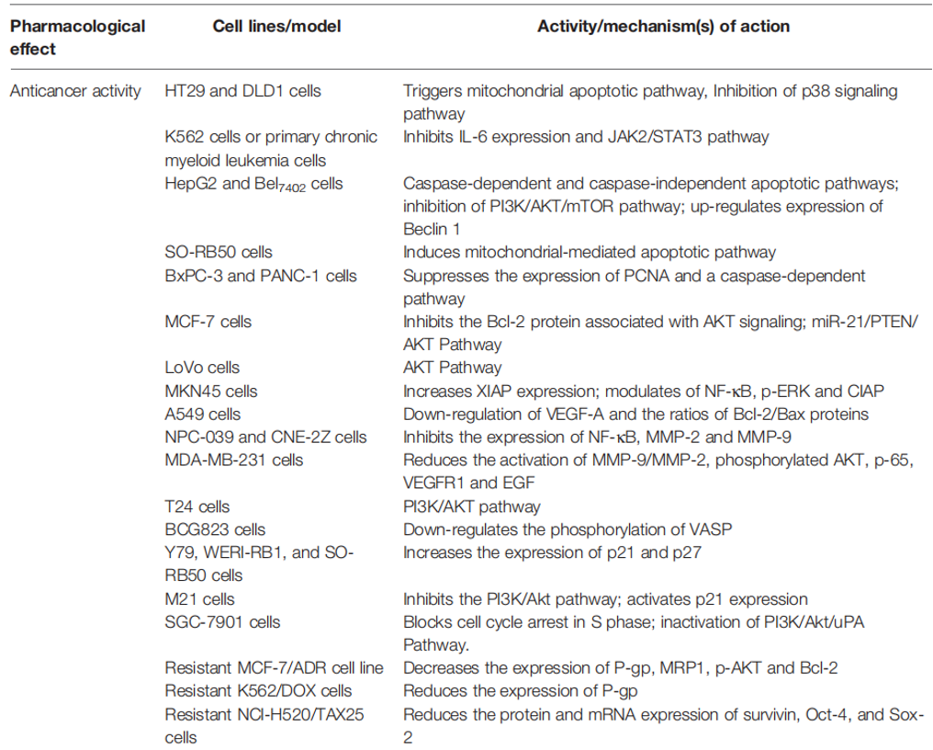
IVIVE System
.…
.…
文件 (F)
编辑 (E)
视图 (V)
工具 (T)
用户 (U)
同步 (S)
帮助 (H)
.…
.…
.…
.…
.…
.…
.…
.…
Administrator
已登录 (L)
退出 (Q)
中药材
基本信息
药效
毒效
ADME属性
药材名称 (26)
山豆根 (Shandougen)
图册
SOPHORAE TONKINENSIS RADIX ET RHIZOMA
重楼
药性
概述总览
药性
寒
药味
苦
药效
抗炎、镇痛、抗菌、抗肿瘤、抗病毒
药效成分
苦参碱
氧化苦参碱
安全剂量
3~6g
作用靶点
前列腺素内过氧化物合酶2(PTGS2）
蛋白质丝氨酸蛋白酶1(PRSS1）
钙调蛋白依赖的蛋白激酶2(CAMKK2）
热休克蛋白90α家族B类成员1(HSP90AB1）、PTGS1等
丁公藤
附子
药味
华山参
药效
金铁锁
*注释—代谢通路
山豆根(2)
苦楝皮
药效成分
化学结构
狼毒
安全剂量
两面针
作用靶点
马钱子
千金子
作用通路
山豆根
商陆
蛇床子
土荆皮
吴茱萸
鸦胆子
芫花
洋金花
IVIVE System Version 1.2
用户名：Administrator D:∖IVIVE System∖Data
Notes:
Medical efficacy

Slide 19
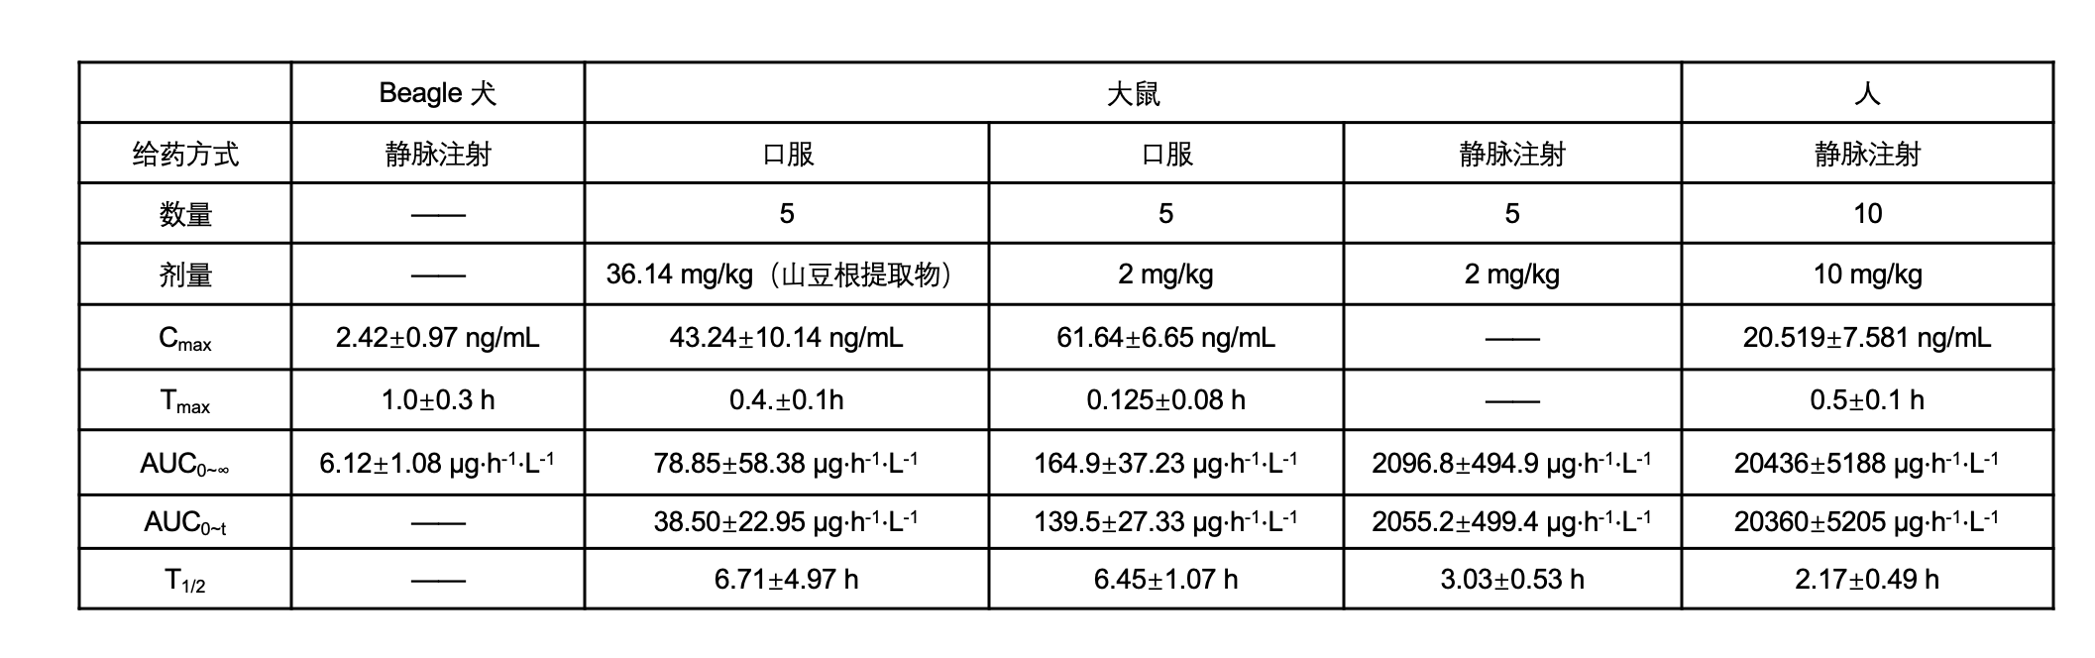
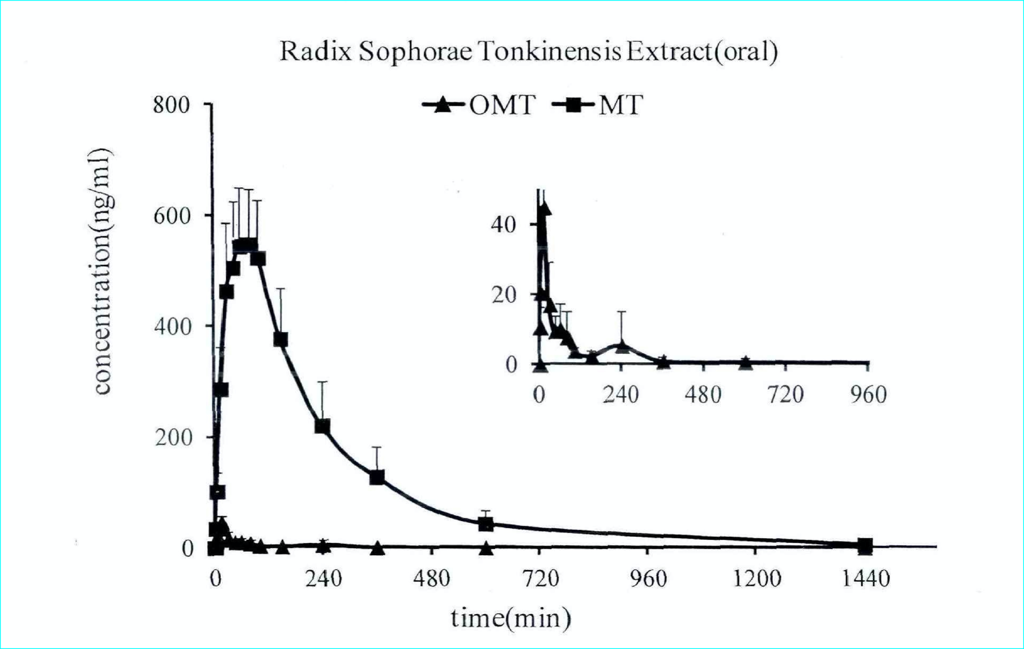
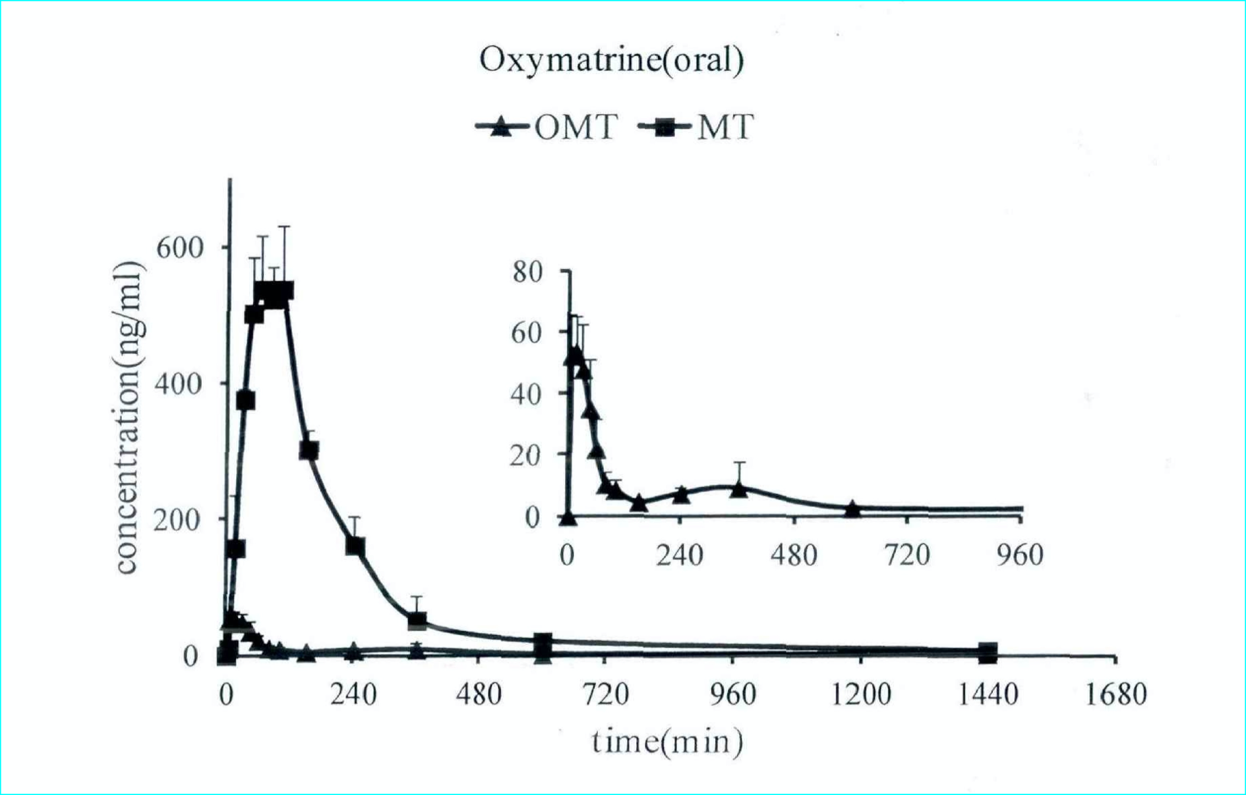
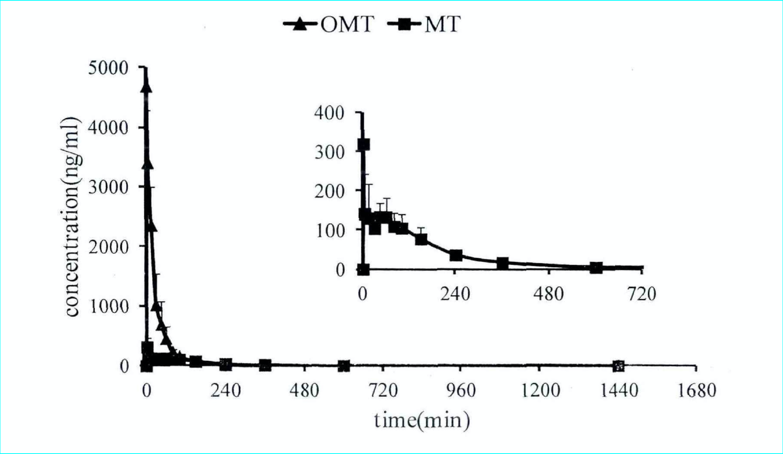
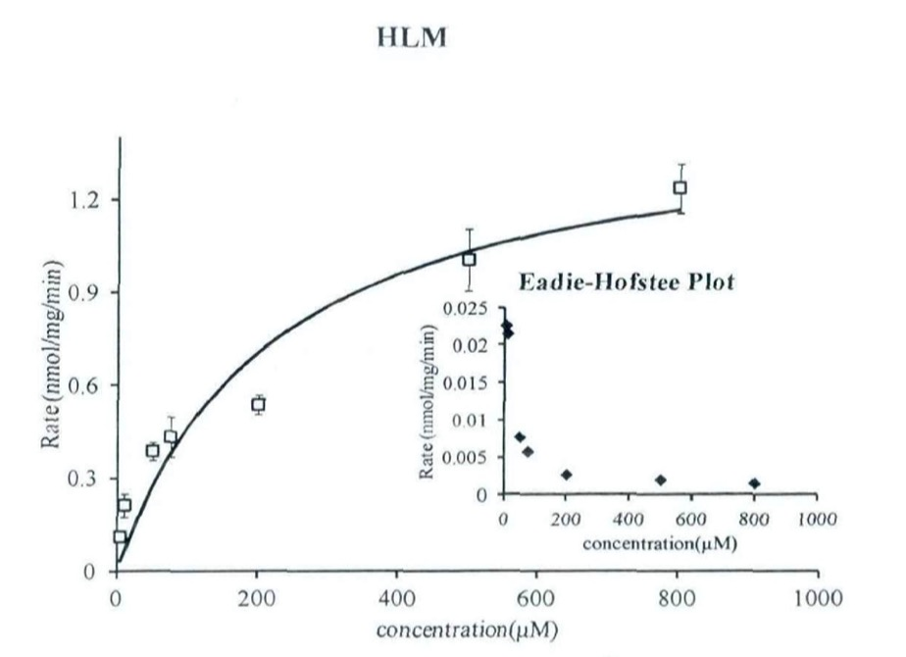
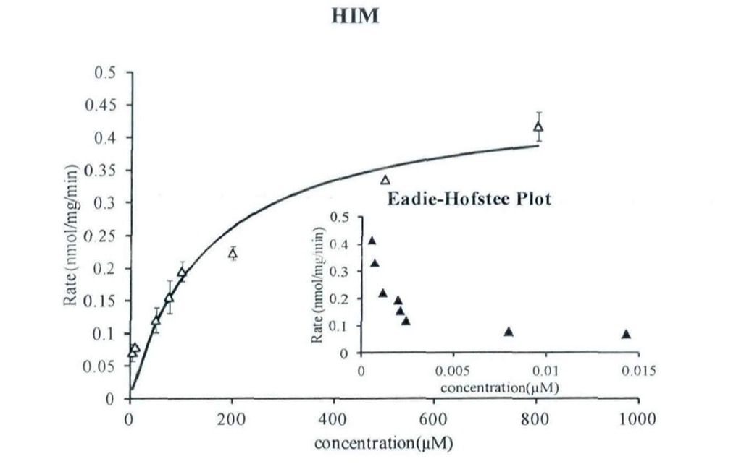
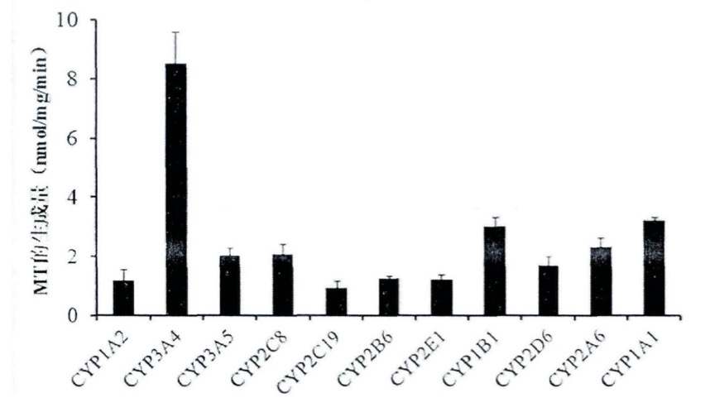
IVIVE System
.…
.…
文件 (F)
编辑 (E)
视图 (V)
工具 (T)
用户 (U)
同步 (S)
帮助 (H)
.…
.…
.…
.…
.…
.…
.…
.…
Administrator
已登录 (L)
退出 (Q)
中药材
基本信息
药效
毒效
ADME属性
药材名称 (26)
山豆根 (Shandougen)
图册
SOPHORAE TONKINENSIS RADIX ET RHIZOMA
重楼
吸收(Absorption)
概述总览
丁公藤
附子
分布(Distribution)
华山参
代谢(Metabolism)
金铁锁
山豆根(2)
苦楝皮
排泄(Excretion)
山豆根单体（氧化苦参碱）大鼠药代动力学数据
化学结构
狼毒
药物相互作用 (DDI)
两面针
PK/PD 性质预测
马钱子
千金子
TK/TD 性质预测
山豆根
商陆
大鼠口服给药山豆根提取物为 36.14 mg/kg（相当于氧化化苦参碱的给药剂量为 2 mg/kg）后血浆中氧化苦参碱的浓度-时间曲线图（n=5）
大鼠口服给药氧化化苦参碱的给药剂量为 2 mg/kg后血浆中氧化苦参碱的浓度-时间曲线图（n=5））
大鼠静脉给药氧化化苦参碱的给药剂量为 2 mg/kg后血浆中氧化苦参碱的浓度-时间曲线图（n=5）
蛇床子
土荆皮
代谢机理
吴茱萸
鸦胆子
芫花
洋金花
IVIVE System Version 1.2
用户名：Administrator D:∖IVIVE System∖Data
Notes:
Here is the report
Pharmacokinetic data, metabolic mechanism

Slide 20
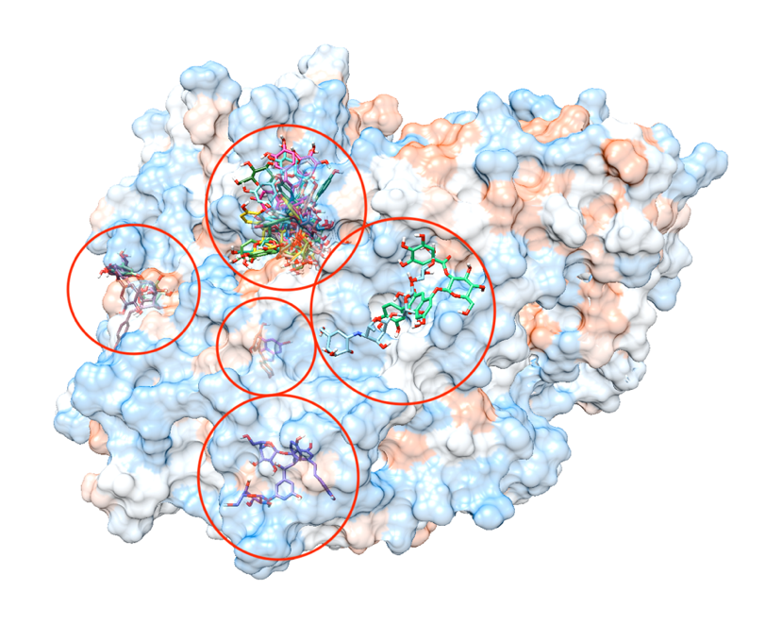
Bioinformatics pipelines
Gene data processing in perl
Blast scripts
Virtual screening

Slide 21
Machine learning
Single cell classification based on human protein altas.
Models for credit default prediction.

Slide 22
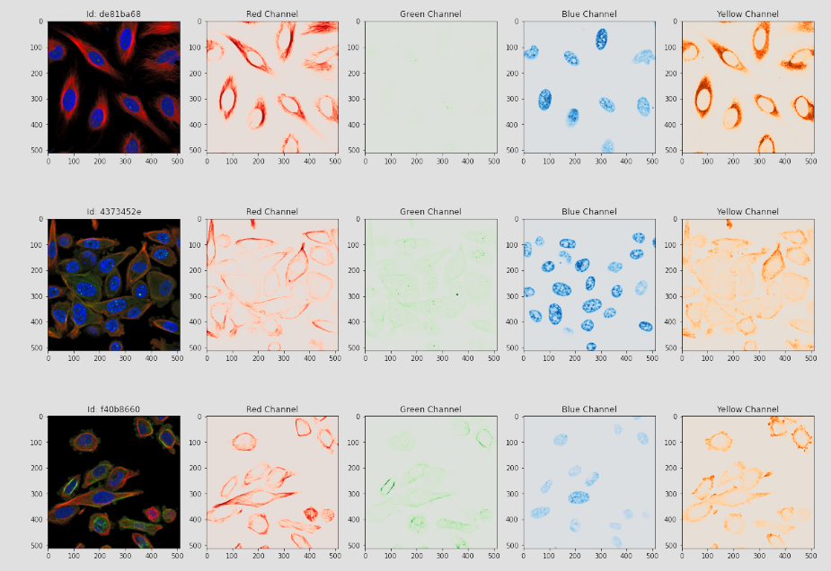
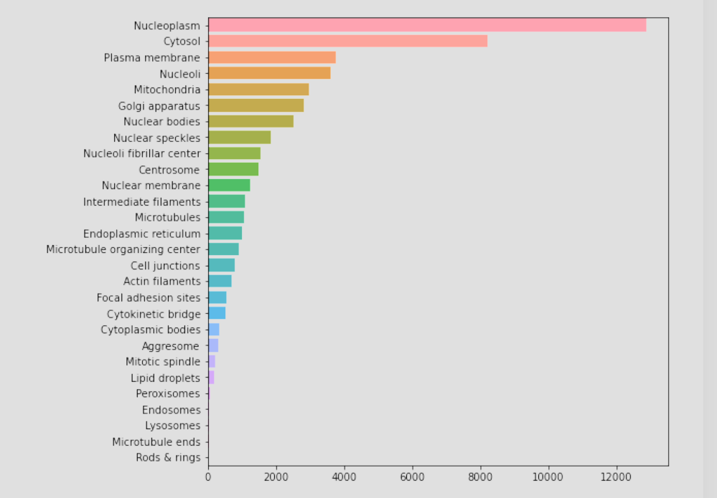
Notes:
Four-channel Convolutional neural network model
Unevenly distributed dataset

Slide 23
Shopping website and wechat mini program

Slide 24
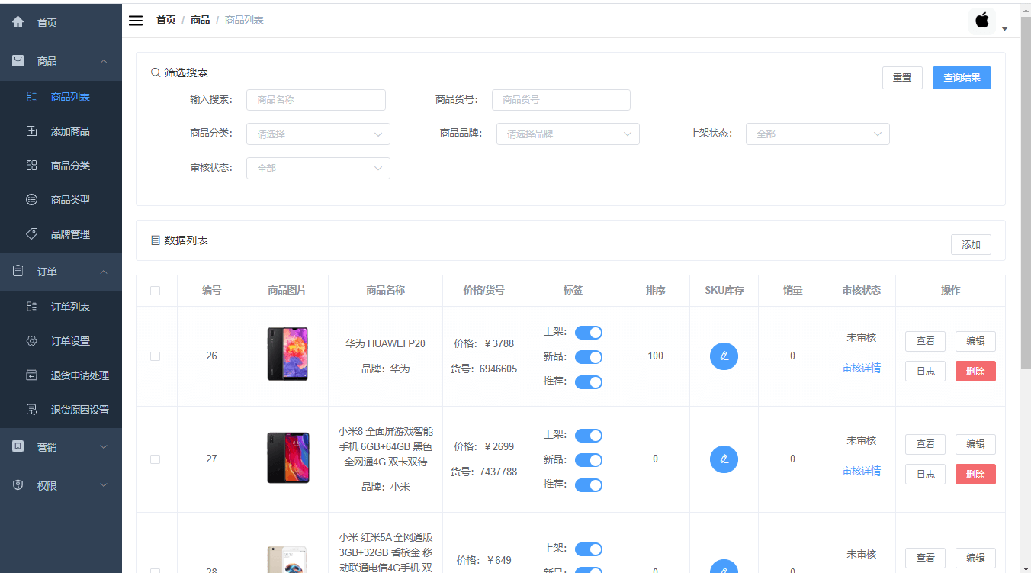
Notes:
Utilised Java, mainly based on SpringBoot, MySQL, MyBatis, and Redis implementation, using B2C mode, SpringMVC three-tier architecture, to develop front and back-end separation.
Realised commodity system, preferential marketing, inventory system, order system, user system, and seckilling function.

Slide 25
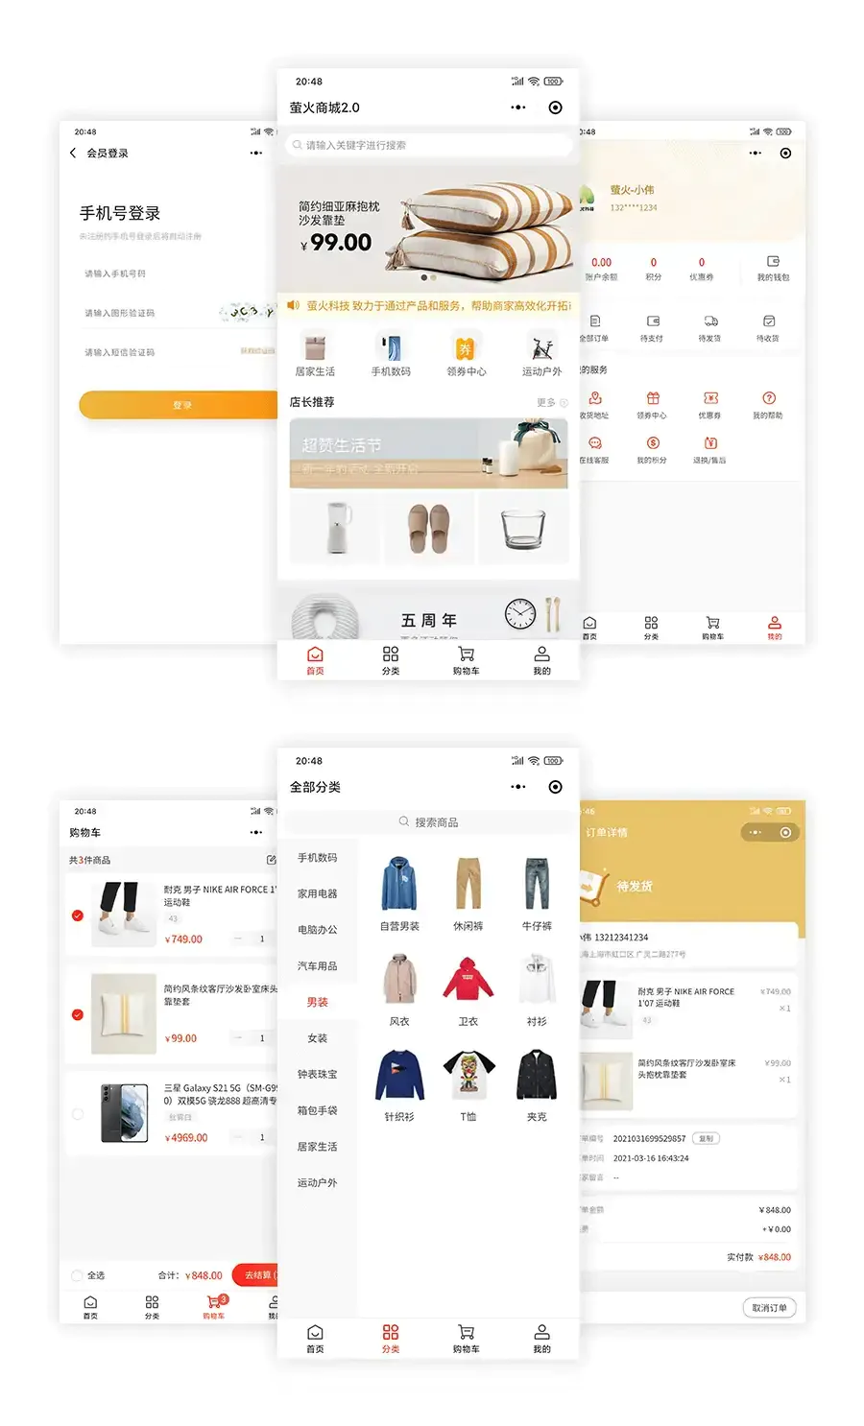
Notes:
Mini program’s interface

Slide 27
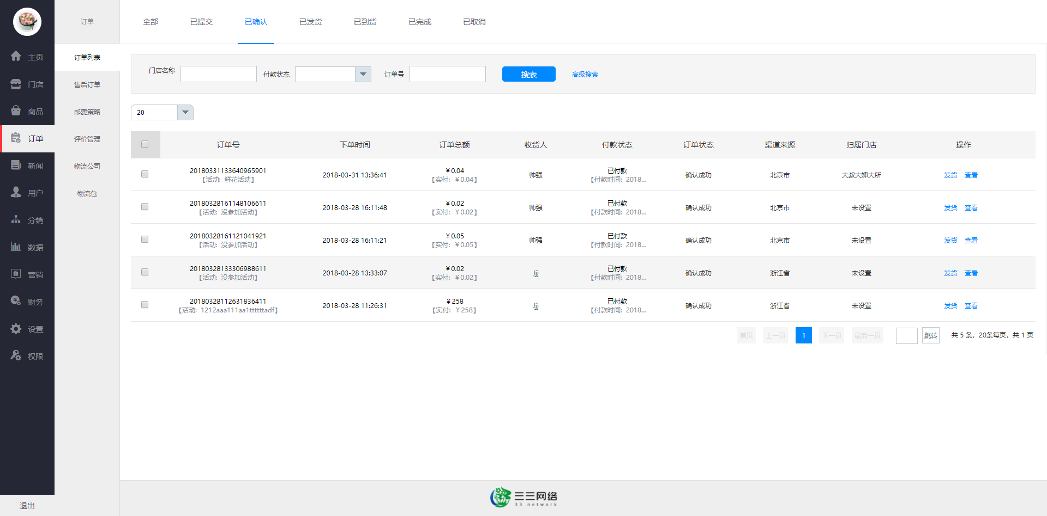
Notes:
Admin system functions like order, inventory management

Slide 28
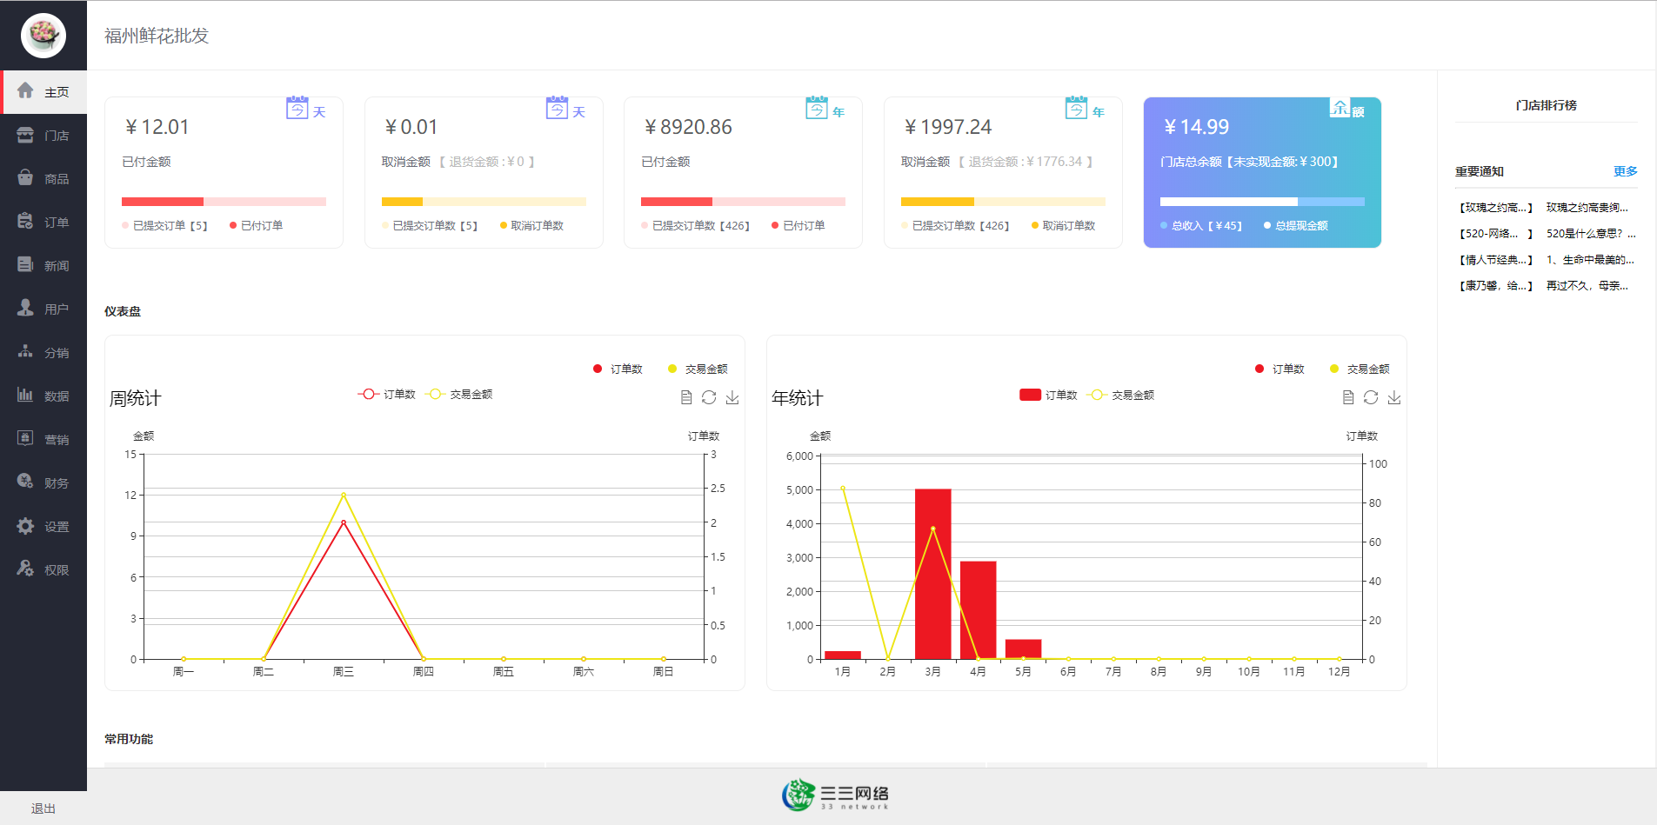
Notes:
and sales statistics

Slide 29
Skill or Problem sharing ~5 min
What’s new?
How Internet Technology Can Improve Biological Workflows
Notes:
Through long-term practice, I believe that technology itself is cheap, and what matters is how to innovate and complete things successfully (there can be many technical routes)
How to find better strategies in plant breeding projects, such as using machine learning to figure out complex genetic mechanism or reduce tedious work.
Data sharing and collaboration platform: Through the Internet, researchers can easily share and obtain large amounts of biological data. Online databases and sharing platforms make it possible to share everything from genetic sequences to ecological data, which promotes collaboration among global researchers and the rapid spread of knowledge.
Cloud computing and big data analysis: Cloud services provide the necessary computing resources to process large-scale biological data, such as genomics, proteomics data, etc. Machine learning and artificial intelligence algorithms can be used to identify patterns and make predictions, which are critical to understanding complex biological systems.
Remote laboratory management: IoT technology allows researchers to remotely monitor and manage laboratory equipment. For example, they can remotely adjust temperature and humidity or monitor the progress of experiments.
Online experimental design and simulation: Internet technology enables researchers to use online tools to design experiments and conduct pre-simulations, thereby optimizing experimental conditions and improving experimental success rates.
Electronic Laboratory Notebook (ELN): Electronic experimental records replace traditional paper experimental notebooks, improving the accuracy, searchability and shareability of data records.
BUT, would it be hard to deploy them, or are they as efficient as we suppose them to be?

